Slide 1

Introduction
to Statistics

Slide 2





Welcome!
Chris Oldnall
Rhys Davies
www.cdcs.ed.ac.uk

Slide 3
Descriptive vs Inferential
Descriptive statistics involve summarizing and presenting the main features of a dataset, such as measures of central tendency (mean, median, mode) and measures of variability (range, standard deviation).
Inferential statistics, aims to make predictions or draw conclusions about a population based on a sample of data, using probability theory and statistical inference techniques like hypothesis testing and confidence intervals.
www.cdcs.ed.ac.uk

Slide 4

Session A:
Descriptive Statistics
www.cdcs.ed.ac.uk

Slide 5
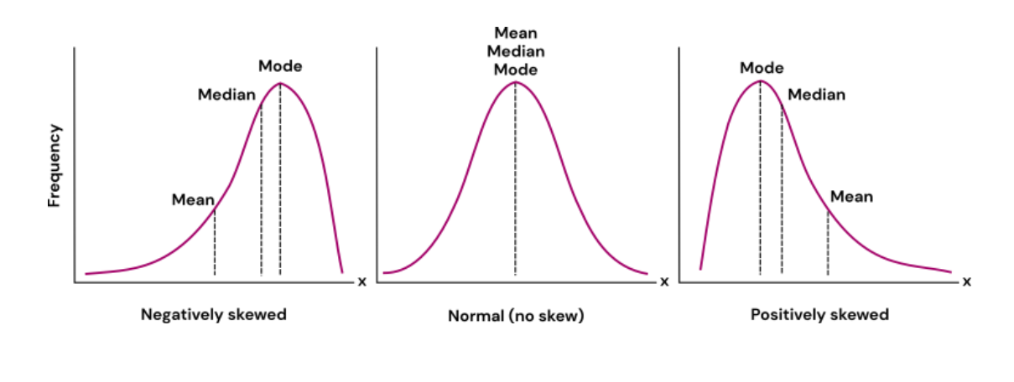
What is a measure of central tendency?
www.cdcs.ed.ac.uk

Slide 6
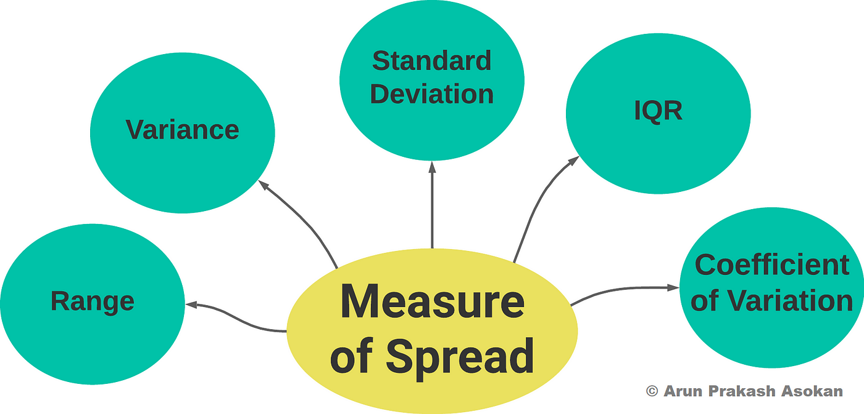
What is a measure of spread?
www.cdcs.ed.ac.uk

Slide 7
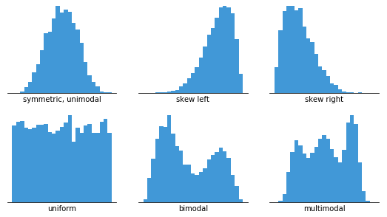
What is a distribution?
www.cdcs.ed.ac.uk

Slide 8
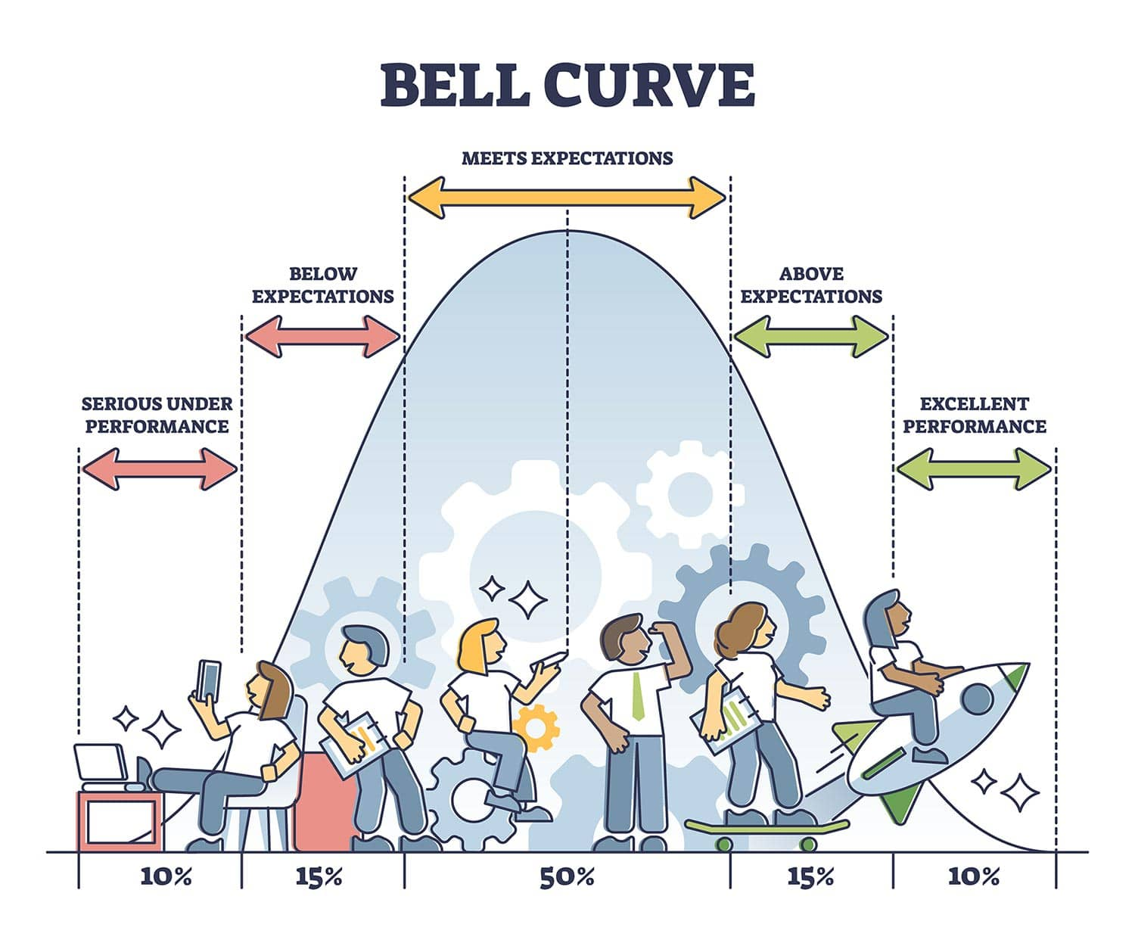
The normal distribution
www.cdcs.ed.ac.uk

Slide 9
Let's do some programming
Notebook A:
What is a summary statistic?
www.cdcs.ed.ac.uk

Slide 10
Session B:
Inferential Statistics
www.cdcs.ed.ac.uk

Slide 11
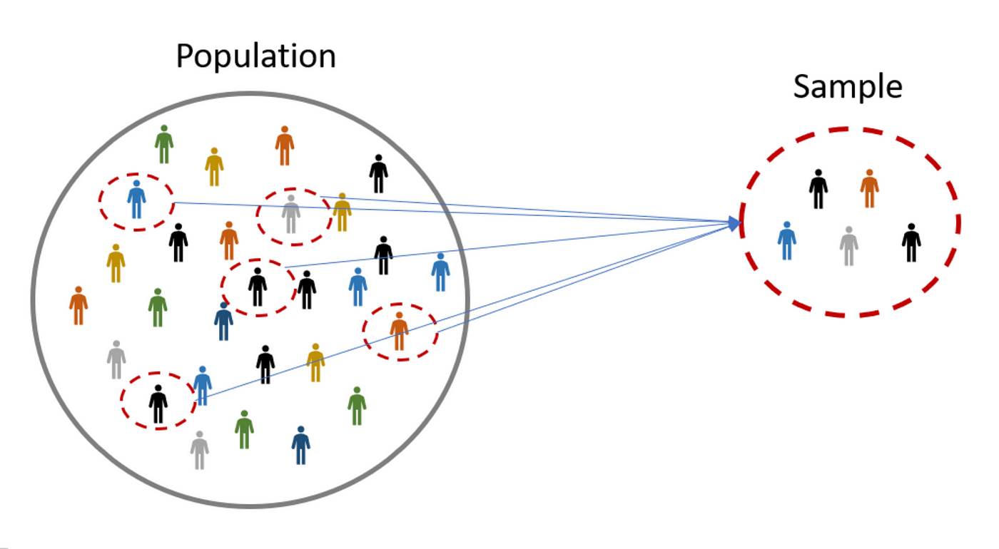
www.cdcs.ed.ac.uk

Slide 12
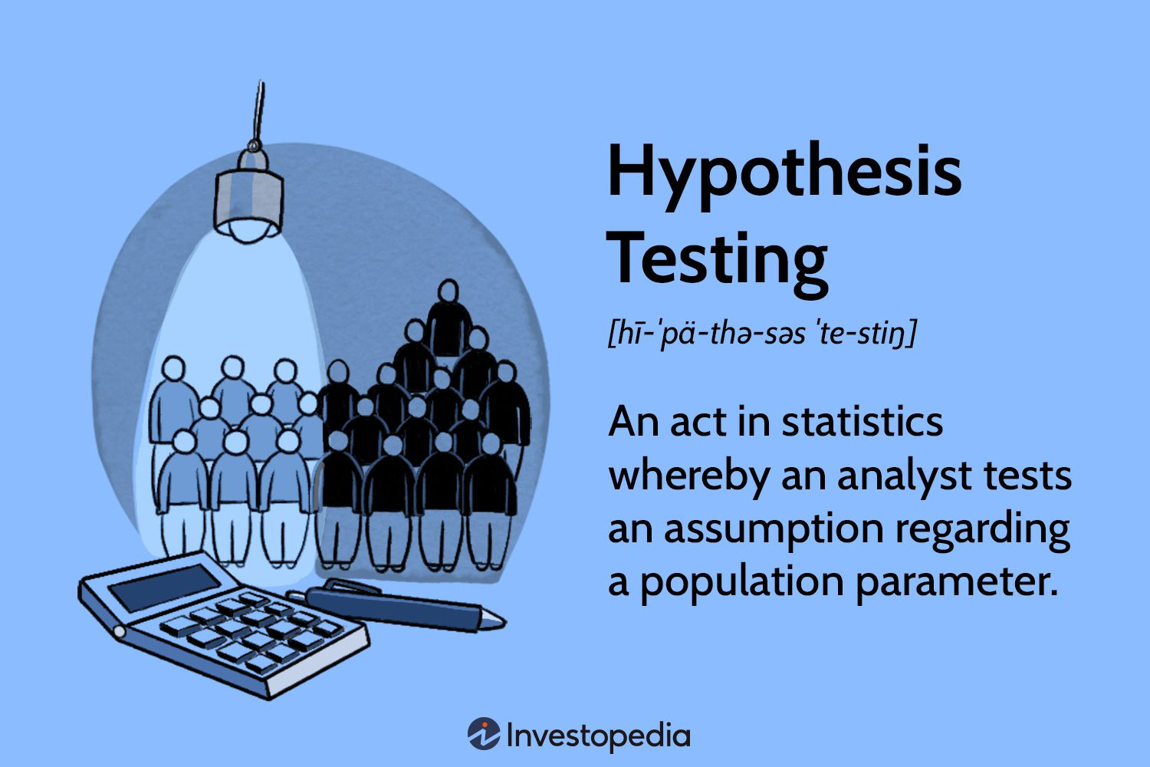
What is a hypothesis?
www.cdcs.ed.ac.uk

Slide 13
How do I formulate a hypothesis?
H0: The current status quo is this.
H1: I believe that it is this instead.
www.cdcs.ed.ac.uk

Slide 14
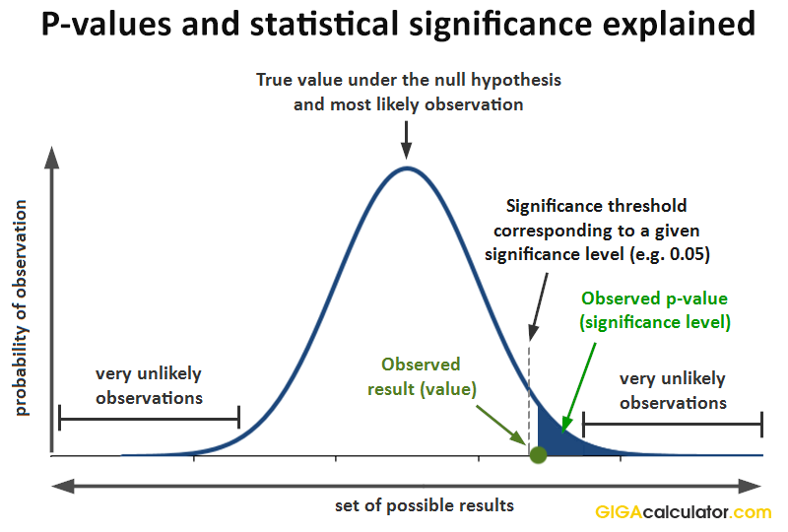
What is a p-value?
www.cdcs.ed.ac.uk

Slide 15
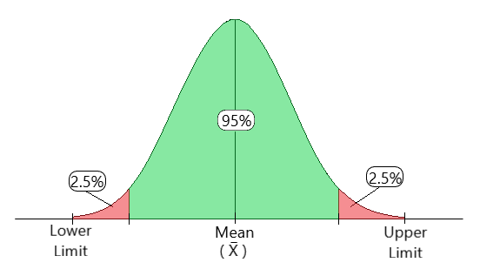
What is a confidence interval?
www.cdcs.ed.ac.uk

Slide 16
Testing a hypothesis.
A null and alternative hypothesis,
Some assumptions,
A test statistic,
Some significance threshold (typically 0.95)
www.cdcs.ed.ac.uk

Slide 17
BIG STATS POINT
REJECT the NULL if p < 0.05 or NOTHING
www.cdcs.ed.ac.uk

Slide 18
A difference in means
= Paired T-Testing
H0: My two groups have the same mean.
H1: My two groups of data have a different mean.
Assume: The data are independent and the means of the data are normally distributed
www.cdcs.ed.ac.uk

Slide 19
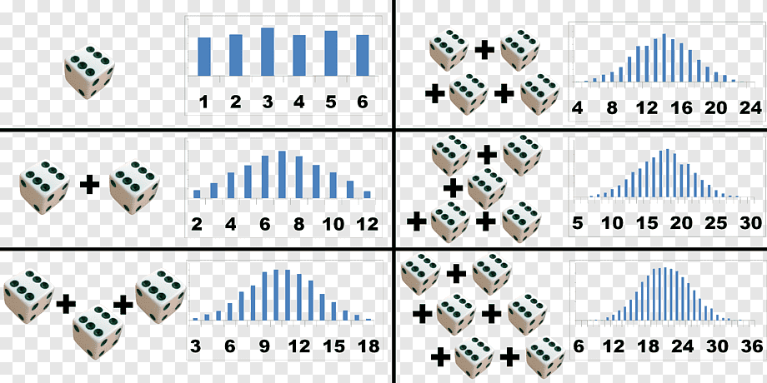
Central Limit Theorem
www.cdcs.ed.ac.uk

Slide 20
Central Limit Theorem
When I have a sample size over 30, I can assume that the mean of the data is normally distributed.
www.cdcs.ed.ac.uk

Slide 21
Let's do some programming
Notebook B:
How do I make inferential statistics?
www.cdcs.ed.ac.uk

Slide 22
Feedback for us...
We hope you've enjoyed the course as much as we did.
It is really useful for us to hear your feedback
https://forms.office.com/r/YYNrqvuNr8
Should be really quick and only take 5 mins (maximum!)
www.cdcs.ed.ac.uk

Slide 23
Thank you from us!
Please do check out the other training on the CDCS website. We have lots of different things still on offer this semester!
www.cdcs.ed.ac.uk

